Slide 1
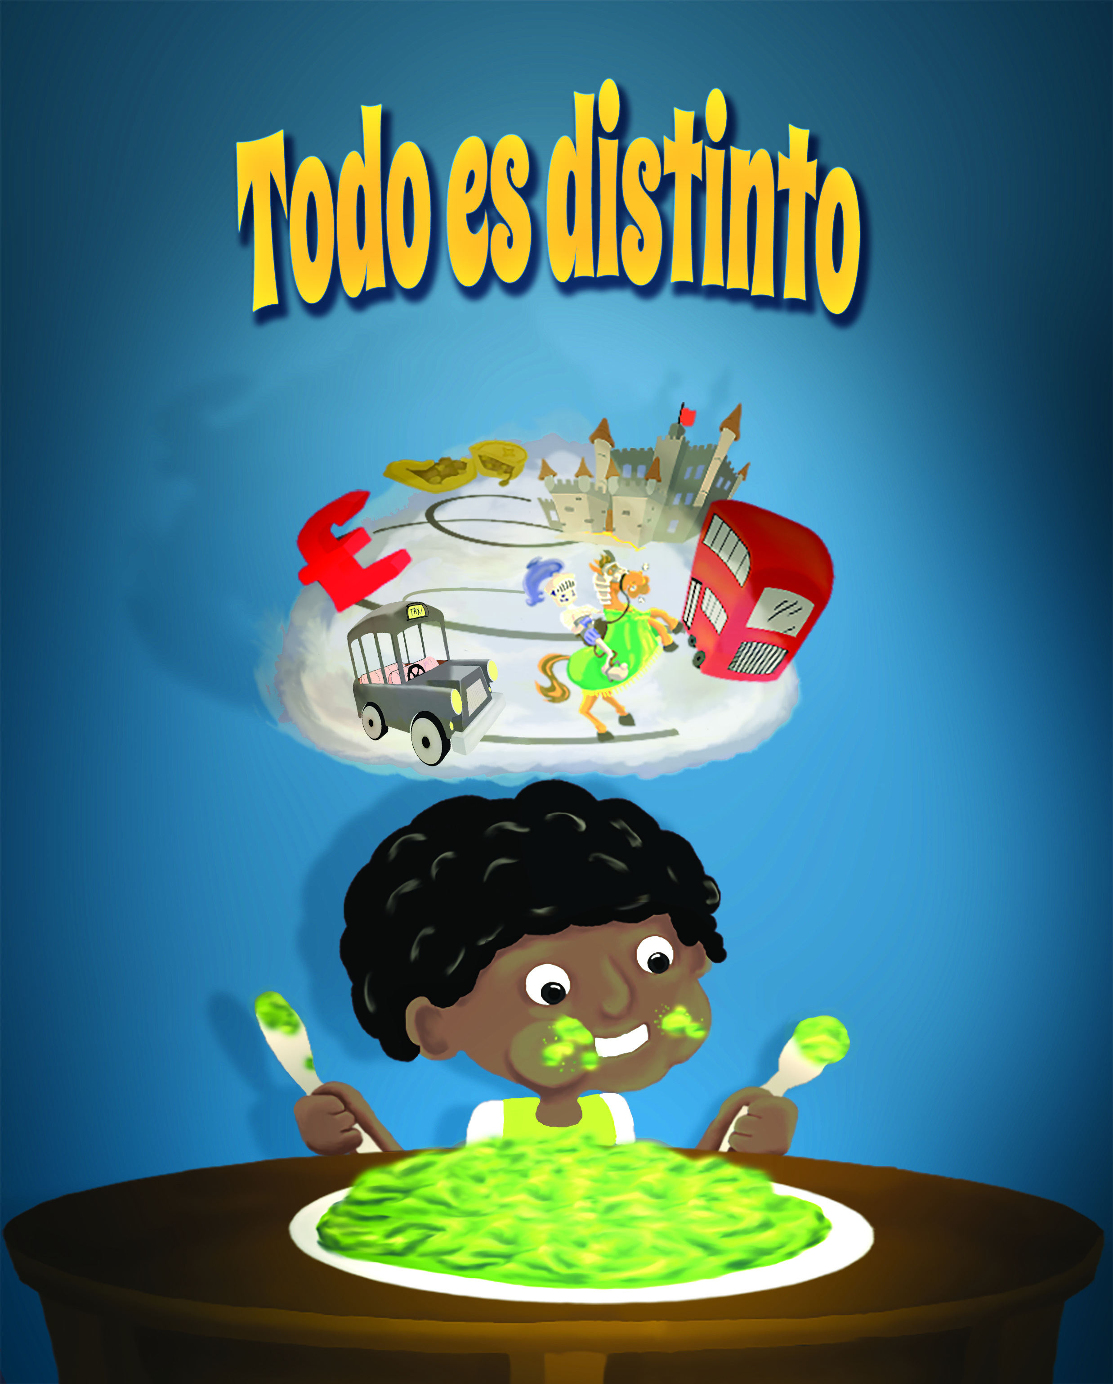
Why Bilingual Children’s Books?
Ann (Ana) Morris
www.authorannmorris.com

Slide 2
Why Children’s Books?
To provide simple stories with learning experiences.
To record memories of family experiences.
To provide early level reading that can be used for native language readers, language learners, remedial supplements for readers and teachers.

Slide 3
What Do I Consider to Be Bilingual?
Equal or nearly equal command in two languages.
This includes listening and speaking AND
Reading and writing.
As with native English speakers, not all native speakers of another language are quality writers.

Slide 4
Why Separate Books instead of One?
To focus on the story and the target language.
NOT to compare the two languages to see how “well” it was translated.
Books written in my native language, English
Books rewritten in Spanish to maintain same spirit, fluidity, ambiance of the original story.

Slide 5
Most Commonly Spoken Languages in the World by Native Speakers
Language¹ | Approx. number of speakers
1. Chinese² | 1,197,000,000
2. Spanish | 414,000,000
3. English | 335,000,000
4. Hindi | 260,000,000
5. Arabic³ | 237,000,000
6. Portuguese | 203,000,000
7. Bengali | 193,000,000
8. Russian | 167,000,000
9. Japanese | 122,000,000
10. Javanese | 84,300,000

Slide 10
Background
BA in Spanish Education from Wartburg College, Waverly, Iowa
Included two study and living experiences, total of over one year, in Pamplona, Spain at La Universidad de Navarra.
First husband of 5 years from Pamplona, Spain. Spanish only spoken at home.
Maintain daily use of language via social networks and local friends.
Have experience with Spanish from different Hispanic countries, recognize localization variations and accents.

Slide 11
Credentials
BA in Spanish Education from Wartburg College, Waverly, Iowa
Included two study and living experiences, total of over one year, in Pamplona, Spain at La Universidad de Navarra.
Taught HS Spanish 18 years at all levels, from children to adult education classes.
Volunteer with Latinos Unidos of Iowa, served as PR Coordinator, recognized as part of Latino community in Des Moines, IA metro area.
Worked with Iowa Workforce as bilingual rep for 12 years, including New Iowan Center. All staff bilingual in English and Spanish.

Slide 12
Travel and/or Friends & Family
Spain (Peninsular) | Mexico
Puerto Rico | Guatemala
El Salvador | Nicaragua
Colombia | Venezuela
Perú | La Argentina
Chile | Honduras
Texas | California
Spain
Mexico
Puerto Rico
Guatemala
El Salvador
Nicaragua
Colombia

